Slide 1
SILENUS WINERY
OAK KNOLL DISTRICT
NAPA VALLEY

Slide 2
“Silenus Winery has been growing grapes for fifty years in what is now known as the Oak Knoll District.
We are proud of our heritage and continue to produce highly regarded wine from grapes grown both at our Estate and from the appellation.
We are blessed with the varied temperatures and alluvial soils that allow a long growing season to create wines that are elegant and nuanced with incredible depth.
Silenus Winery remains committed to producing what we believe are the best wines from the best appellation.”
Scott Meadows, President

Slide 3
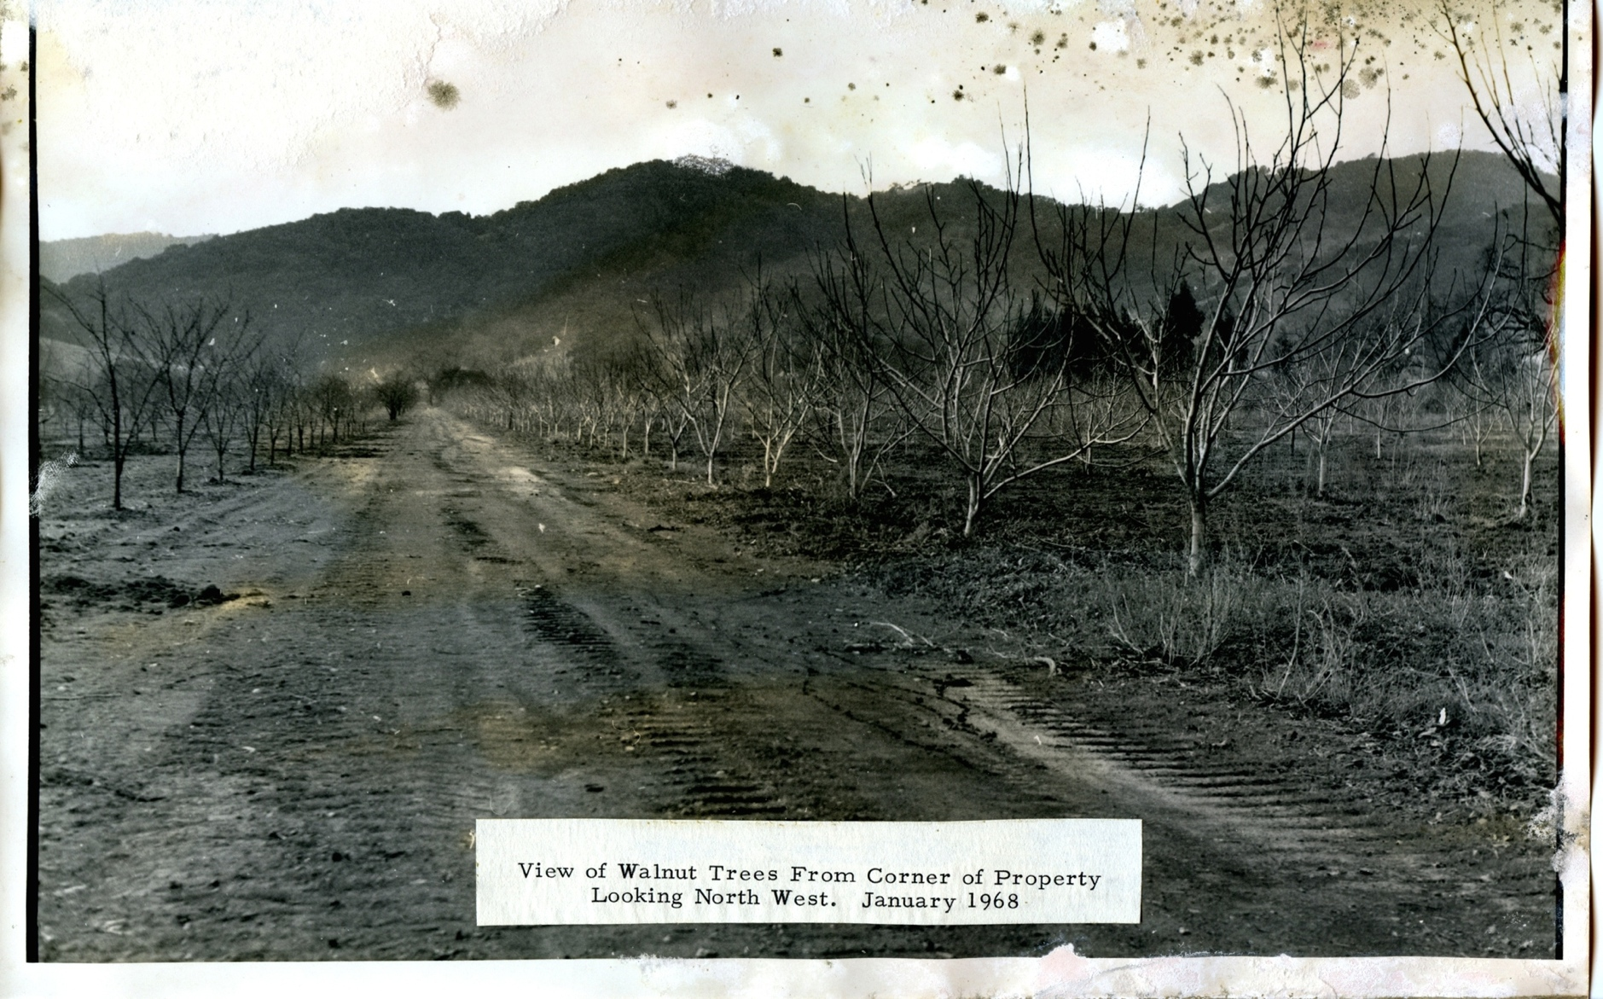
Silenus Today
Silenus Winery:
Walnuts
to
Grapes

Slide 4
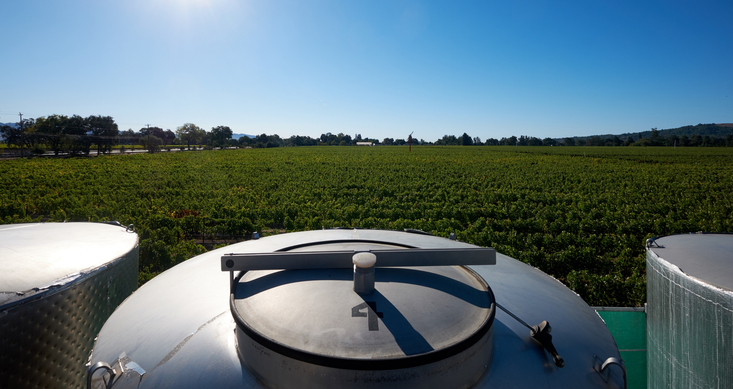
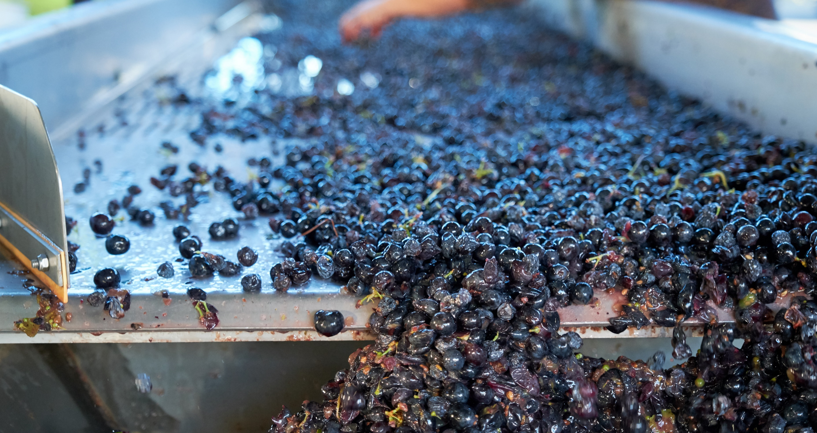
50 YEARS OF SILENUS WINERY
In 1968 a walnut orchard on the southwestern slope of Napa Valley was converted to Cabernet Sauvignon vineyards and the roots of Silenus Winery were firmly established. In 2004 this area became one of the sixteen sub AVAs (American Viticultural Area) in Napa Valley and is now known as Oak Knoll District of Napa Valley.
The vineyards were originally planted by aerospace engineer Bruce Newlan, and quickly gained a superior reputation. Through the 1970’s the grapes from this vineyard were sold to Robert Mondavi, Inglenook, Silver Oak and Clos du Val and consistently were used in their reserve wines.
Realizing what gold this 20-acre vineyard produced, Newlan built his own winery and began producing award winning wines. Silenus is now celebrating 50 years of growing some of the most sought after grapes in Napa Valley.

Slide 5
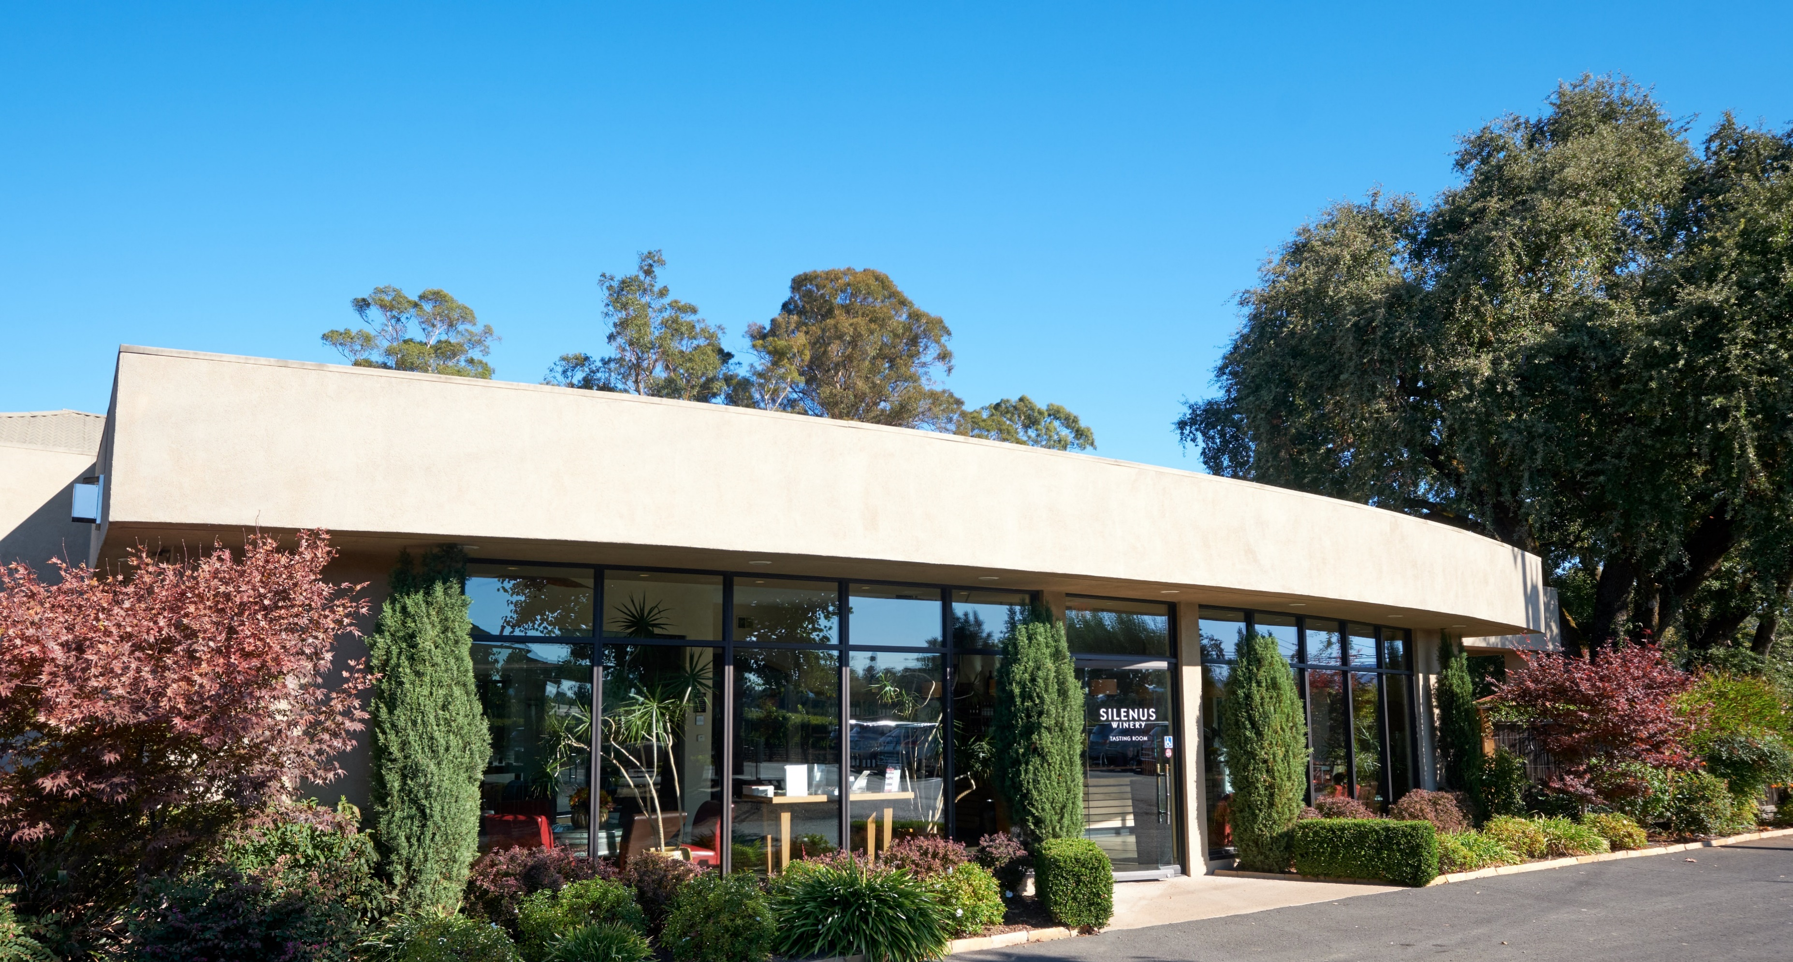
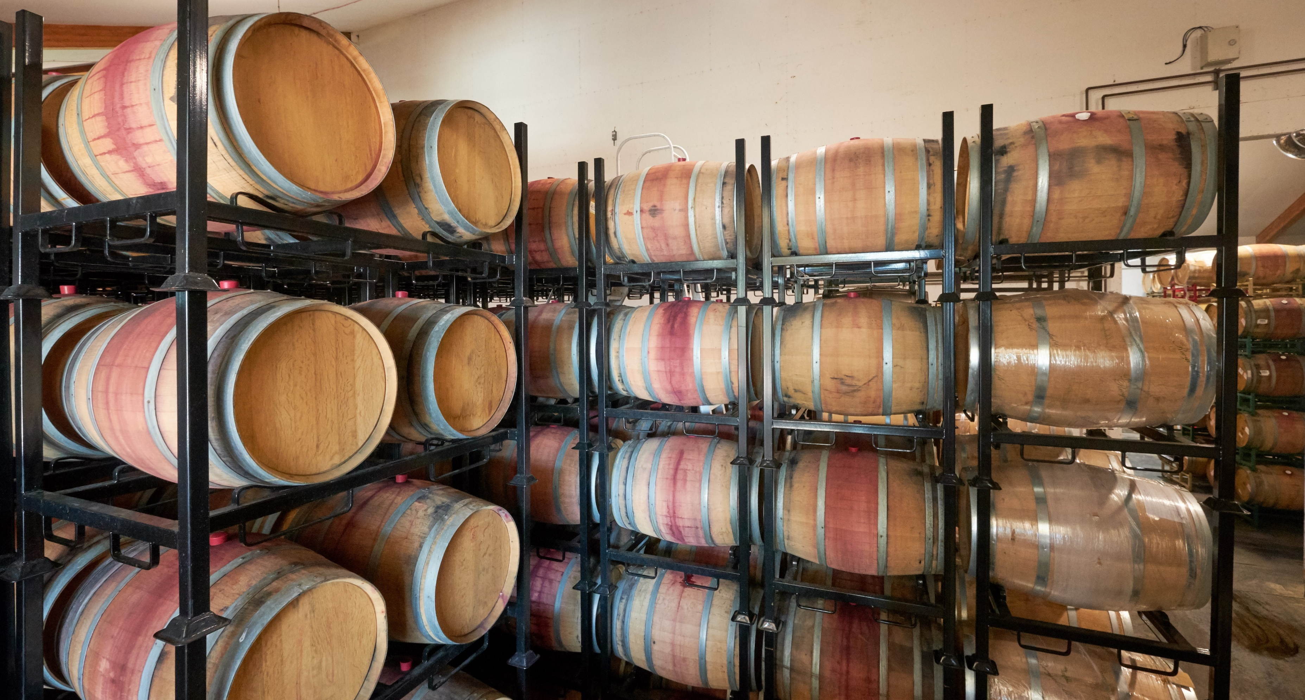
Silenus Winery – 2018
Newlan sold the winery in the late 90’s, and in 2000 Scott Meadows was hired as President. The winery was rechristened Silenus Winery. Purchased by Chinese entrepreneur Veronica Wang in 2010, Scott remains as President today. Because of this Asian connection, Silenus wines until now have been sold almost exclusively in China and Japan.
Over the years, state of the art production equipment, a 2,000 barrel aging cellar and a gleaming, modern tasting room have been added. The winery continues the tradition of small-production, premium winemaking. Silenus wines are now launching in select markets of the United States as well as expanding their international presence.

Slide 6
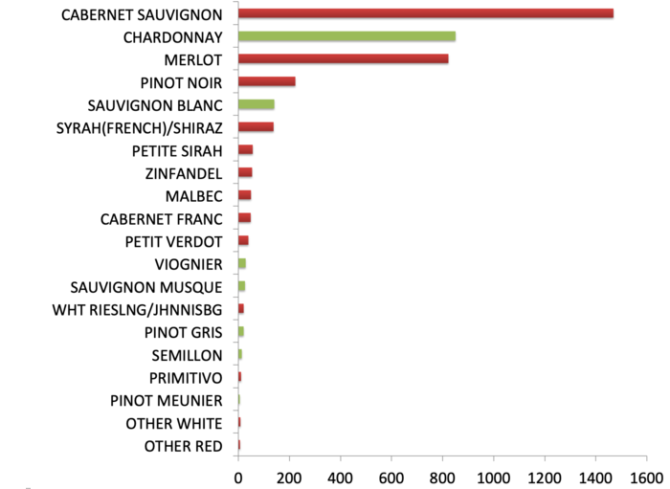
OAK KNOLL DISTRICT OF NAPA VALLEY
The Oak Knoll District (OKD) is known as the Sweet Spot of Napa appellations because of its range of temperatures and soils, giving the area the ability to grow many different grape varietals.
It is also one of Napa Valley’s oldest grape growing areas dating back to 1851. Today it is over 4,200 acres planted to almost 20 grape varietals.

Slide 7
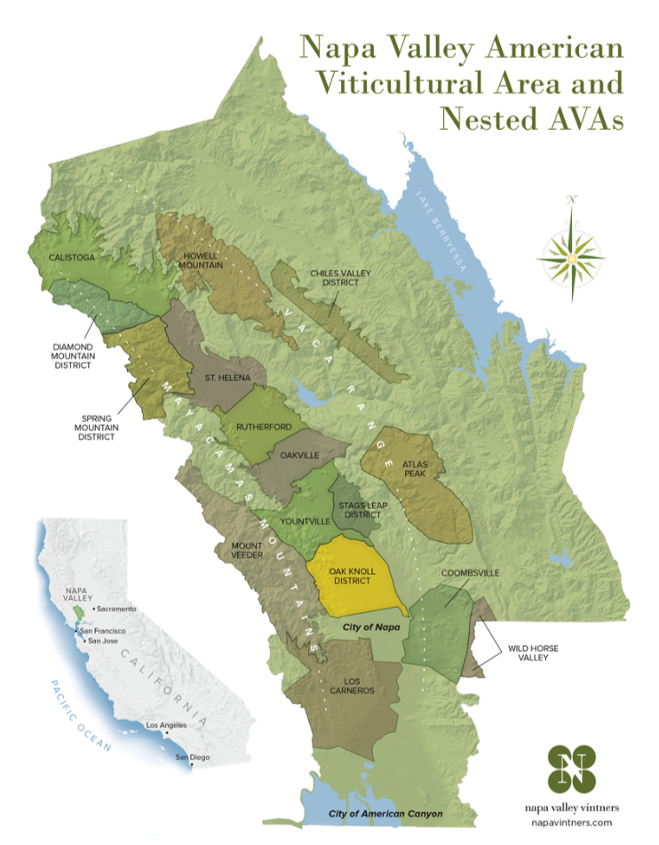
OAK KNOLL DISTRICT OF NAPA VALLEY
The topography of the AVA starts just south of the town of Yountville and ends just north of the town of Napa.
The western border starts at the top of Mount Veeder, where its downward slopes created alluvial soils from millennia of runoff from the mountain.
At the center of the appellation the land levels off and the soil becomes clay. Extending to the Silverado Trail, the AVA offers temperatures easily ten degrees warmer than St. Helena, and rainfall significantly higher.
With this range of climate and soil, Oak Knoll District can easily grow a mixture of grape types, thus earning the nickname The Sweet Spot.

Slide 8
THE WINES of SILENUS
The winery produces four wines, all from Oak Knoll District.
Chardonnay – from Red Hen Vineyard and Matthiasson Vineyards
Merlot – from Materra Vineyards
Cabernet Sauvignon – from the Silenus Estate just south of Darms Lane in the Mayacamas Watershed
Cabernet Sauvignon Reserve – the best of the best from the Estate. Small production and limited.

Slide 9
PRESS FOR SILENUS WINERY Consistently High Scores
OAK KNOLL CHARDONNAY
2017
94 Points & Editor’s Choice Wine Enthusiast
92 Points James Suckling
91 Points The Tasting Panel, Anthony Dias Blue
OAK KNOLL MERLOT
2015
90 Points Decanter World Wine Awards
90 Points Wine Enthusiast
OAK KNOLL CABERNET SAUVIGNON
2016
94 Points James Suckling
92 Points Jeb Dunnuck
2015
92 Points Wine Spectator
92 Points James Suckling
91 Points Wine Enthusiast
90 Points Jeb Dunnuck
OAK KNOLL CABERNET SAUVIGNON, RESERVE
2016
92 Points Robert Parker
94 Points Jeb Dunnuck
90 Points James Suckling
2015
97 Points and Platinum Decanter Wine Awards
90 Points James Suckling
2014 Cabernet Reserve
94 Points Wine Enthusiast
94 Points The Tasting Panel Magazine, Anthony Dias Blue
93 Points Wine Spectator
93 Points 2013 Jeb Dunnuck
TYROS CABERNET SAUVIGNON
2015
92 Points Decanter
91 Points & Editor’s Choice Wine Enthusiast
92 Points Blue Lifestyle, Anthony Dias Blue

Slide 10
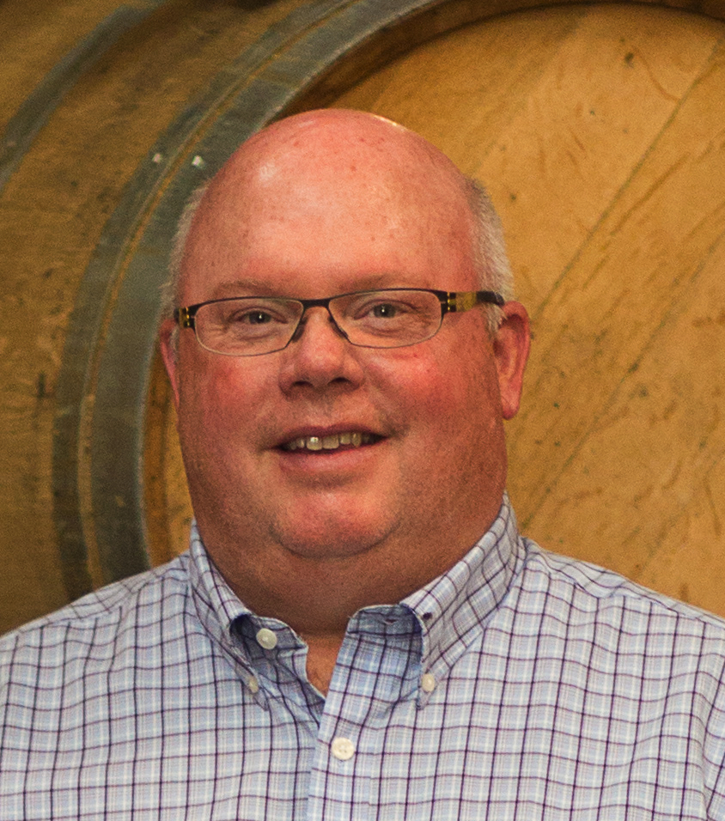
Scott Meadows, President
A native of Utah, Scott worked in Tokyo for years in marketing for language learning software for Apple. Scott has been President of Silenus for almost twenty years. He, his Japanese wife and two daughters live in Napa.

Slide 11
Veronica Wang, Owner
Ms. Wang is a native of Zhengzhou, a city in central China known as the transportation hub from the Silk Road. Originally a property developer of many large residential buildings, she has expanded her reach to several other interests.
While living in Los Angeles, she discovered her love of wine and purchased Silenus Winery, and then recently created Meijing Vineyards in China, a luxury destination for high profile events.
Because of her many travels, she saw the future of private aviation so purchased and expanded Mooney Aviation (located in Texas) which produces high end performance aircraft.
Veronica has also been very philanthropic, donating generously to children’s education and is building health clinics in China in conjunction with The Mayo Clinic.

Slide 12
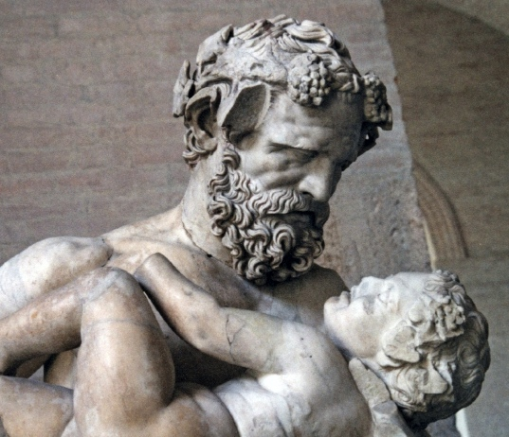
Silenus, Mentor of Dionysus
Silenus Winery is named in honor of the mentor and companion of Dionysus, the Greek god of wine. Zeus, father of Dionysus, charged Silenus with raising Dionysus from birth teaching him to focus on the most important things needed for a full life of hedonism and pleasure.
Key among the teachings was the art of planting and caring for grape vines to make the best wine possible. During ancient times wines were often flavored and sweetened with honey so Silenus also taught Dionysus how to raise bees to make the sweetest and most flavorful honey.

Slide 13
Our new logo represents elements from both Silenus and Tyros. From the Silenus label is the pinecone at the top, bees to the left, a grapevine at the bottom, and to the right is our Tyros T from the capsule of Tyros Cabernet, all crossed with the fennel stalks from the center of the Silenus label.

Slide 14
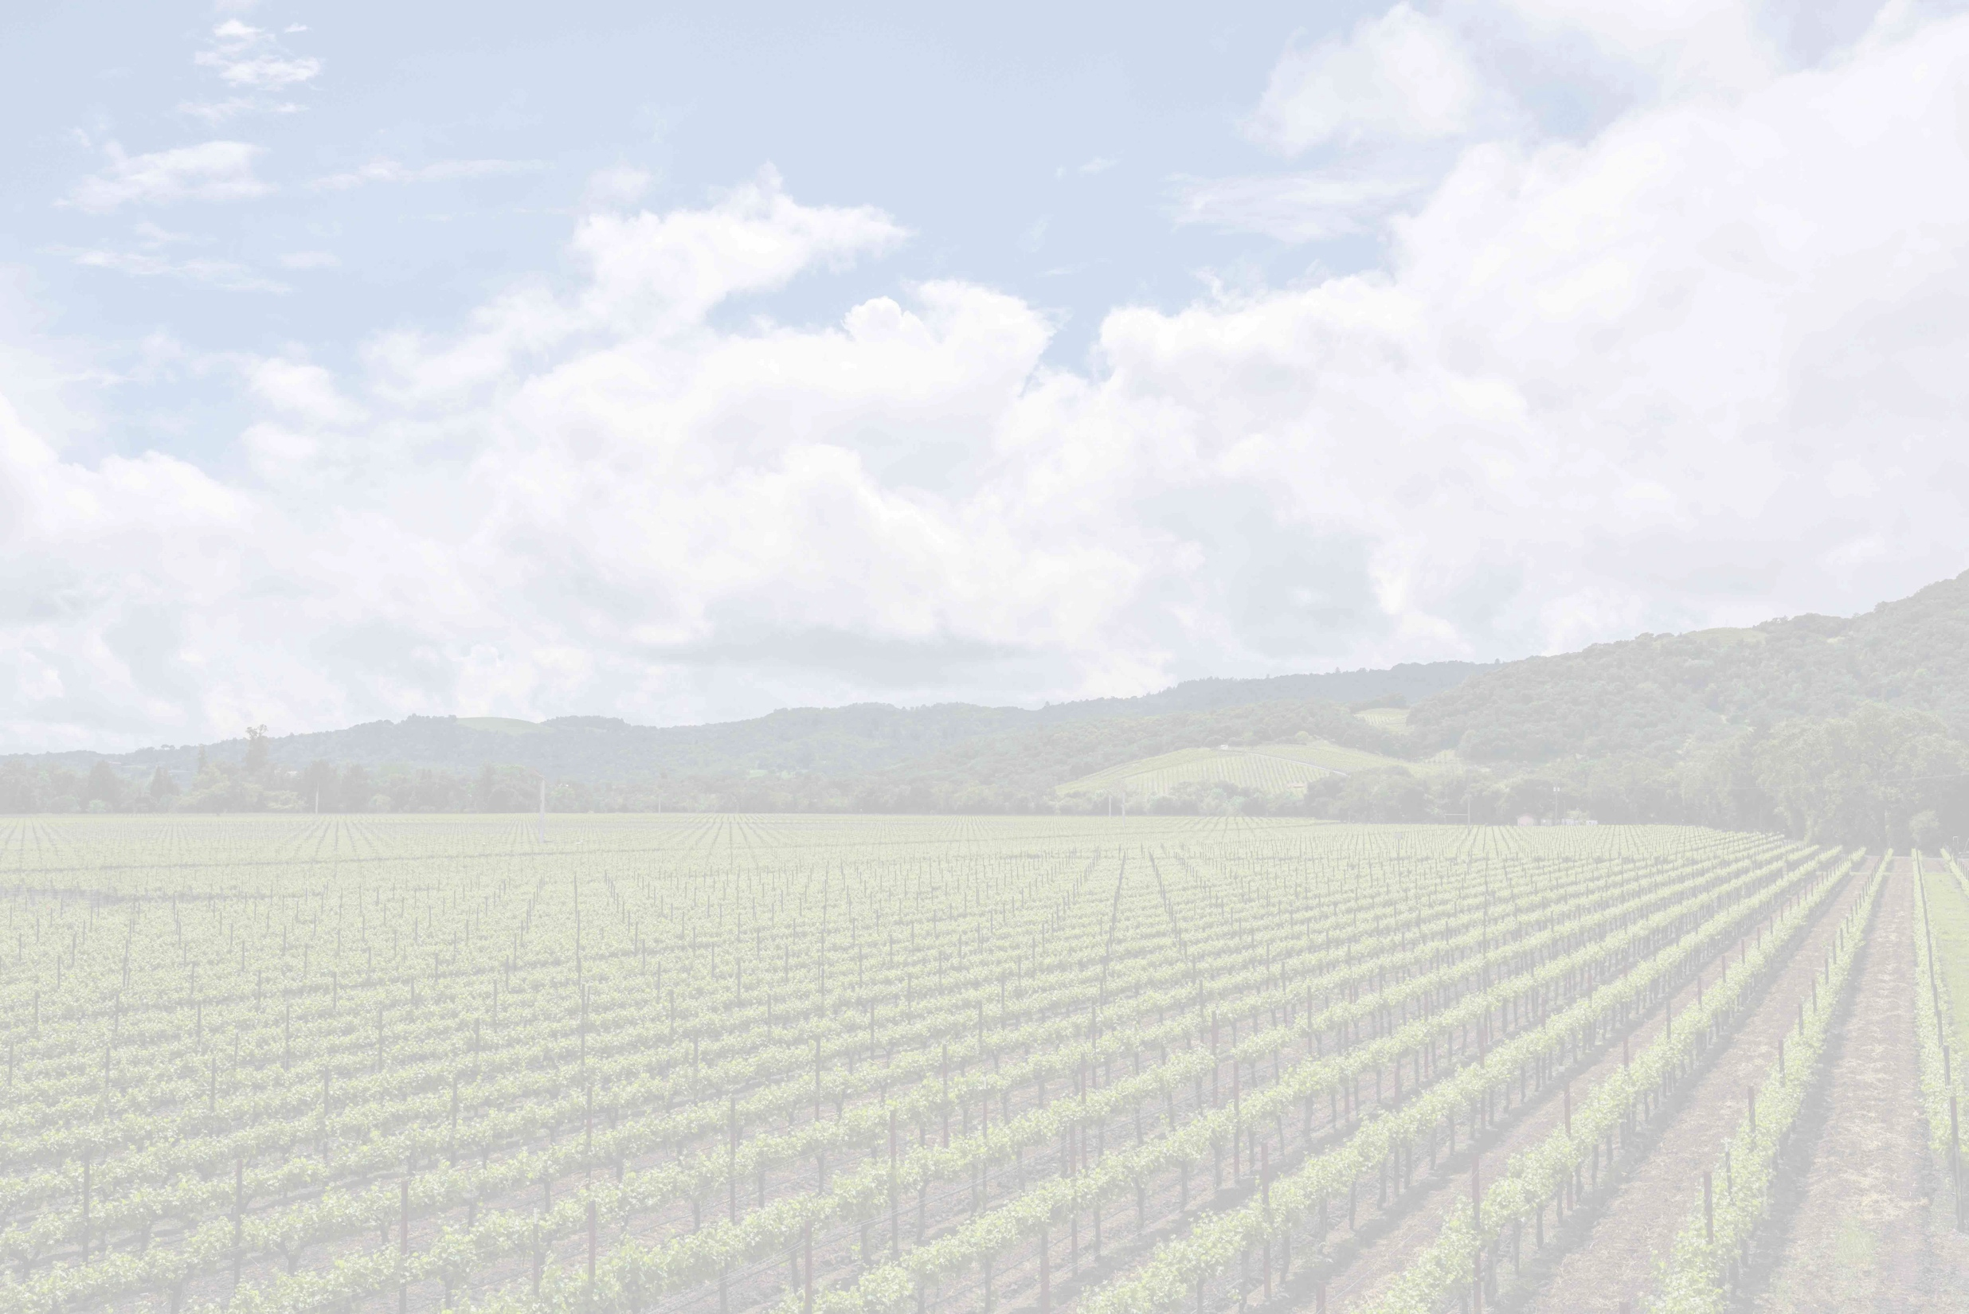
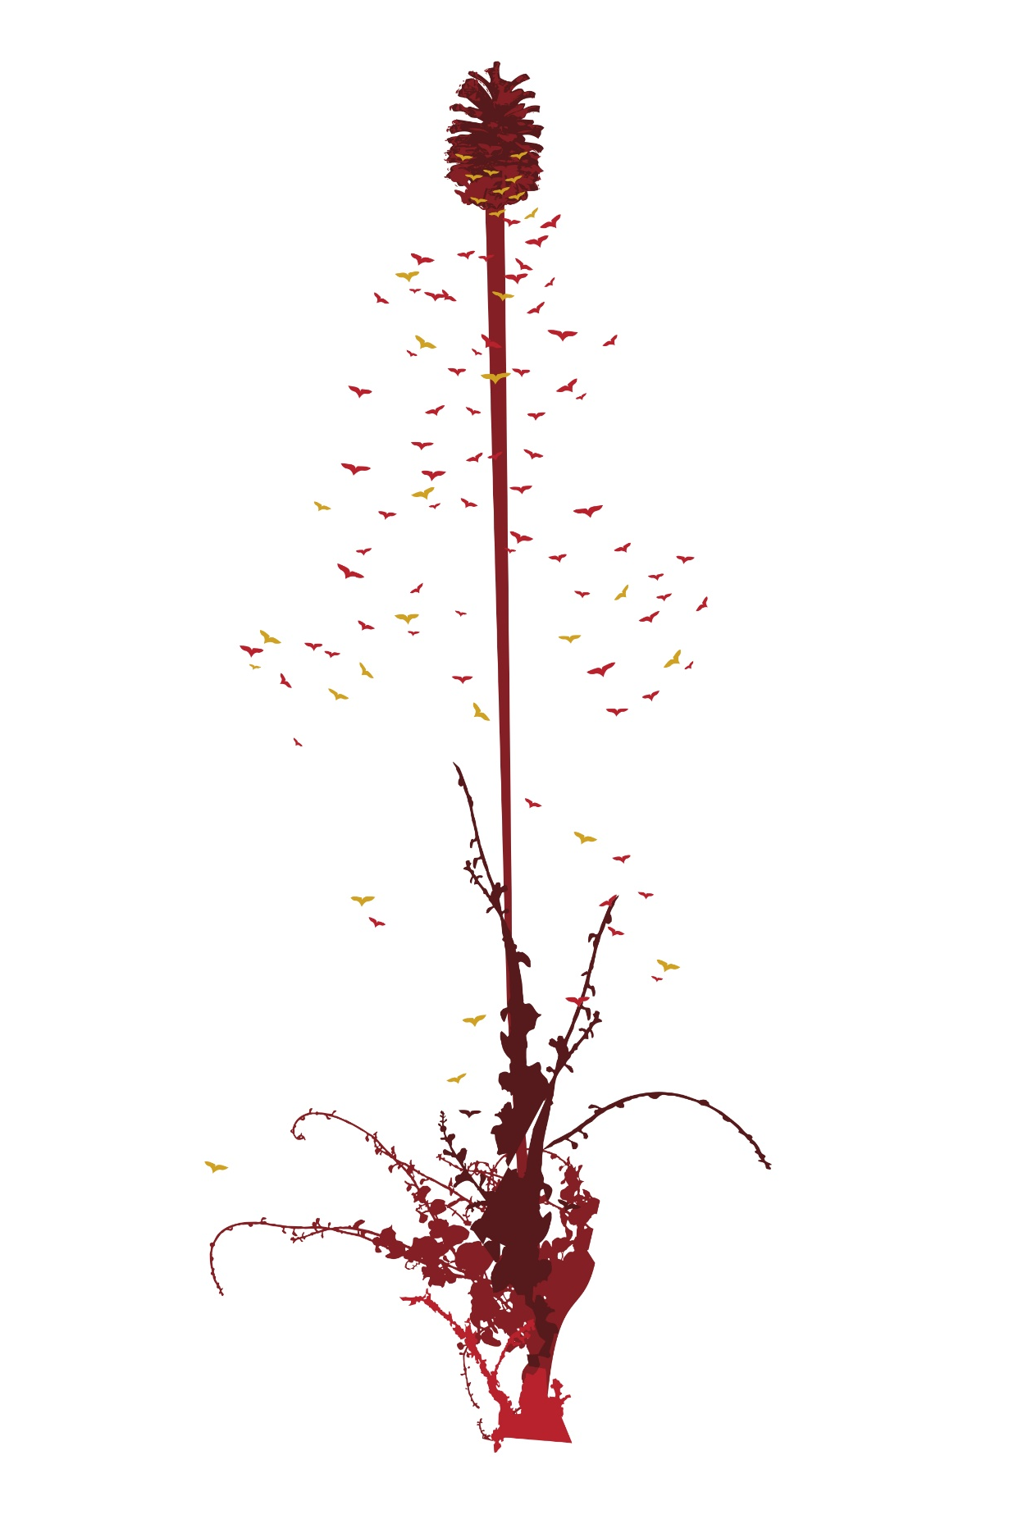
The Silenus Label
As Silenus and Dionysus traveled the lands far and wide, they hosted parties and planted vineyards. While traveling they always carried with them a fennel staff topped by a pinecone, a both a sign of welcome and hospitality.
The Silenus label pays homage to that welcome and combines four elements: a newly planted grapevine sprouting a fennel stalk, topped with a honeyed pinecone encircled by bees.

Slide 15
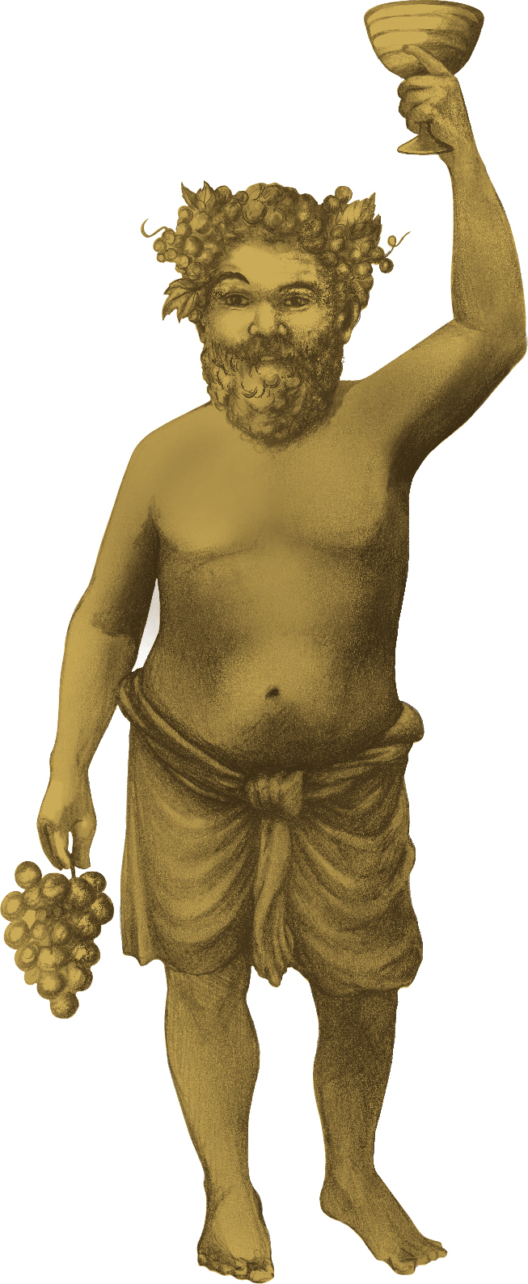
TYROS
Napa Valley Cabernet Sauvignon
Tyros = “a beginner or apprentice”
According to Greek mythology, Zeus, God of all Gods, appointed Silenus to teach his fledgling son, Dionysus, God of Wine, how to enjoy the pleasure of life, also known as debauching. Silenus took this task to heart. As Silenus was mentor to Dionysus, Dionysus became apprentice to Silenus. This whimsical label depicts Dionysus as the Tyros, inviting all to join him in the pleasures of wine.
Produced from grapes purchased throughout Napa Valley, our Tyros Cabernet Sauvignon celebrates great wine made to be accessible and enjoyed with the pleasures of a great meal.

Slide 16
TYROS 2015 Cabernet Sauvignon Napa Valley
In the first vintage of Tyros Cabernet, the 2015 Tyros is a blend of 78% Cabernet Sauvignon and 22% Merlot. A percentage of the wine is from the Silenus Estate, with the balance of the Cab coming differing vineyards in the Valley. The Merlot is from northeast of the town of Napa. The wine has been aged in oak for 22 months in 60% new French and American oak and 40% neutral oak. The deep ruby red color shows wild berry and sweet oak on the nose. The palate is rich and deep with layers of raspberry, cherry, and plum rounded out with a touch of fig, vanilla and cocoa. The long finish is red fruit, cappuccino and cedar.

Slide 17
TYROS 2017 Cabernet Sauvignon Napa Valley
The 2017 vintage is 77% Cabernet Sauvignon and 23% Merlot. Sourced from Napa Valley appellations including Pope Valley in the northern valley, down through St. Helena and the Oak Knoll district and end up in the Carneros AVA in the southern end of the valley. The Cabernet Sauvignon portion of the wine includes 8% from the Silenus Estate Vineyards and another 21% from the Oak Knoll District AVA, 17% from the St. Helena AVA, 7% from Pope Valley. The Merlot comes primarily from the Oak Knoll AVA with 15% and the Carneros AVA with 8%.
The wine was aged for 22 months in 50% new French oak, 10% new American oak and the rest in neutral barrels. This blend of oak integrates perfectly with the lush fruitiness of the wine and lends just the right amount of tannins for a perfect balance.

