Slide 1
SILENUS WINERY
OAK KNOLL DISTRICT
of NAPA VALLEY

Slide 2
“Silenus Winery, with over 50 years of growing grapes in Napa Valley’s Oak Knoll District, is committed to producing wines that define this unique terroir and our estate vineyard. The alluvial soils combined with the varied temperatures create perfect growing conditions for wines that are both elegant and nuanced with incredible depth. Silenus Winery remains committed to producing what we believe are the best wines from the best appellation.”
Scott Meadows, President

Slide 3
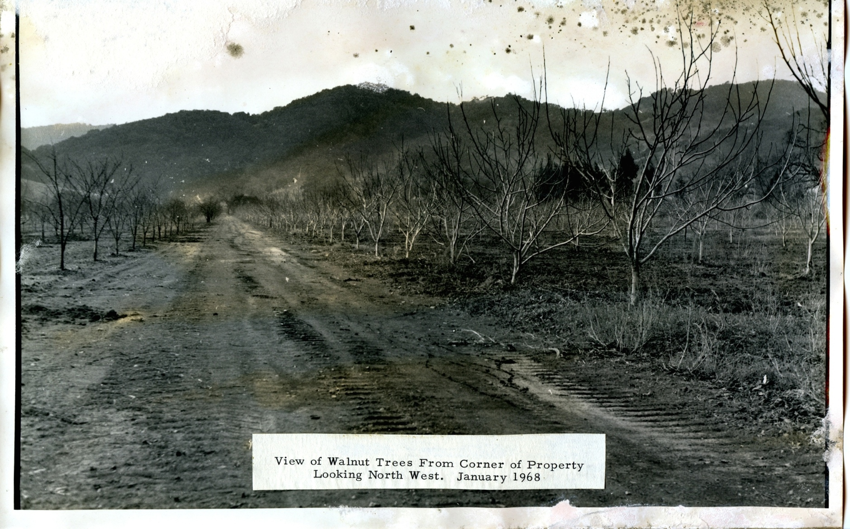
Silenus Today
Silenus Winery:
Walnuts
to
Grapes

Slide 4
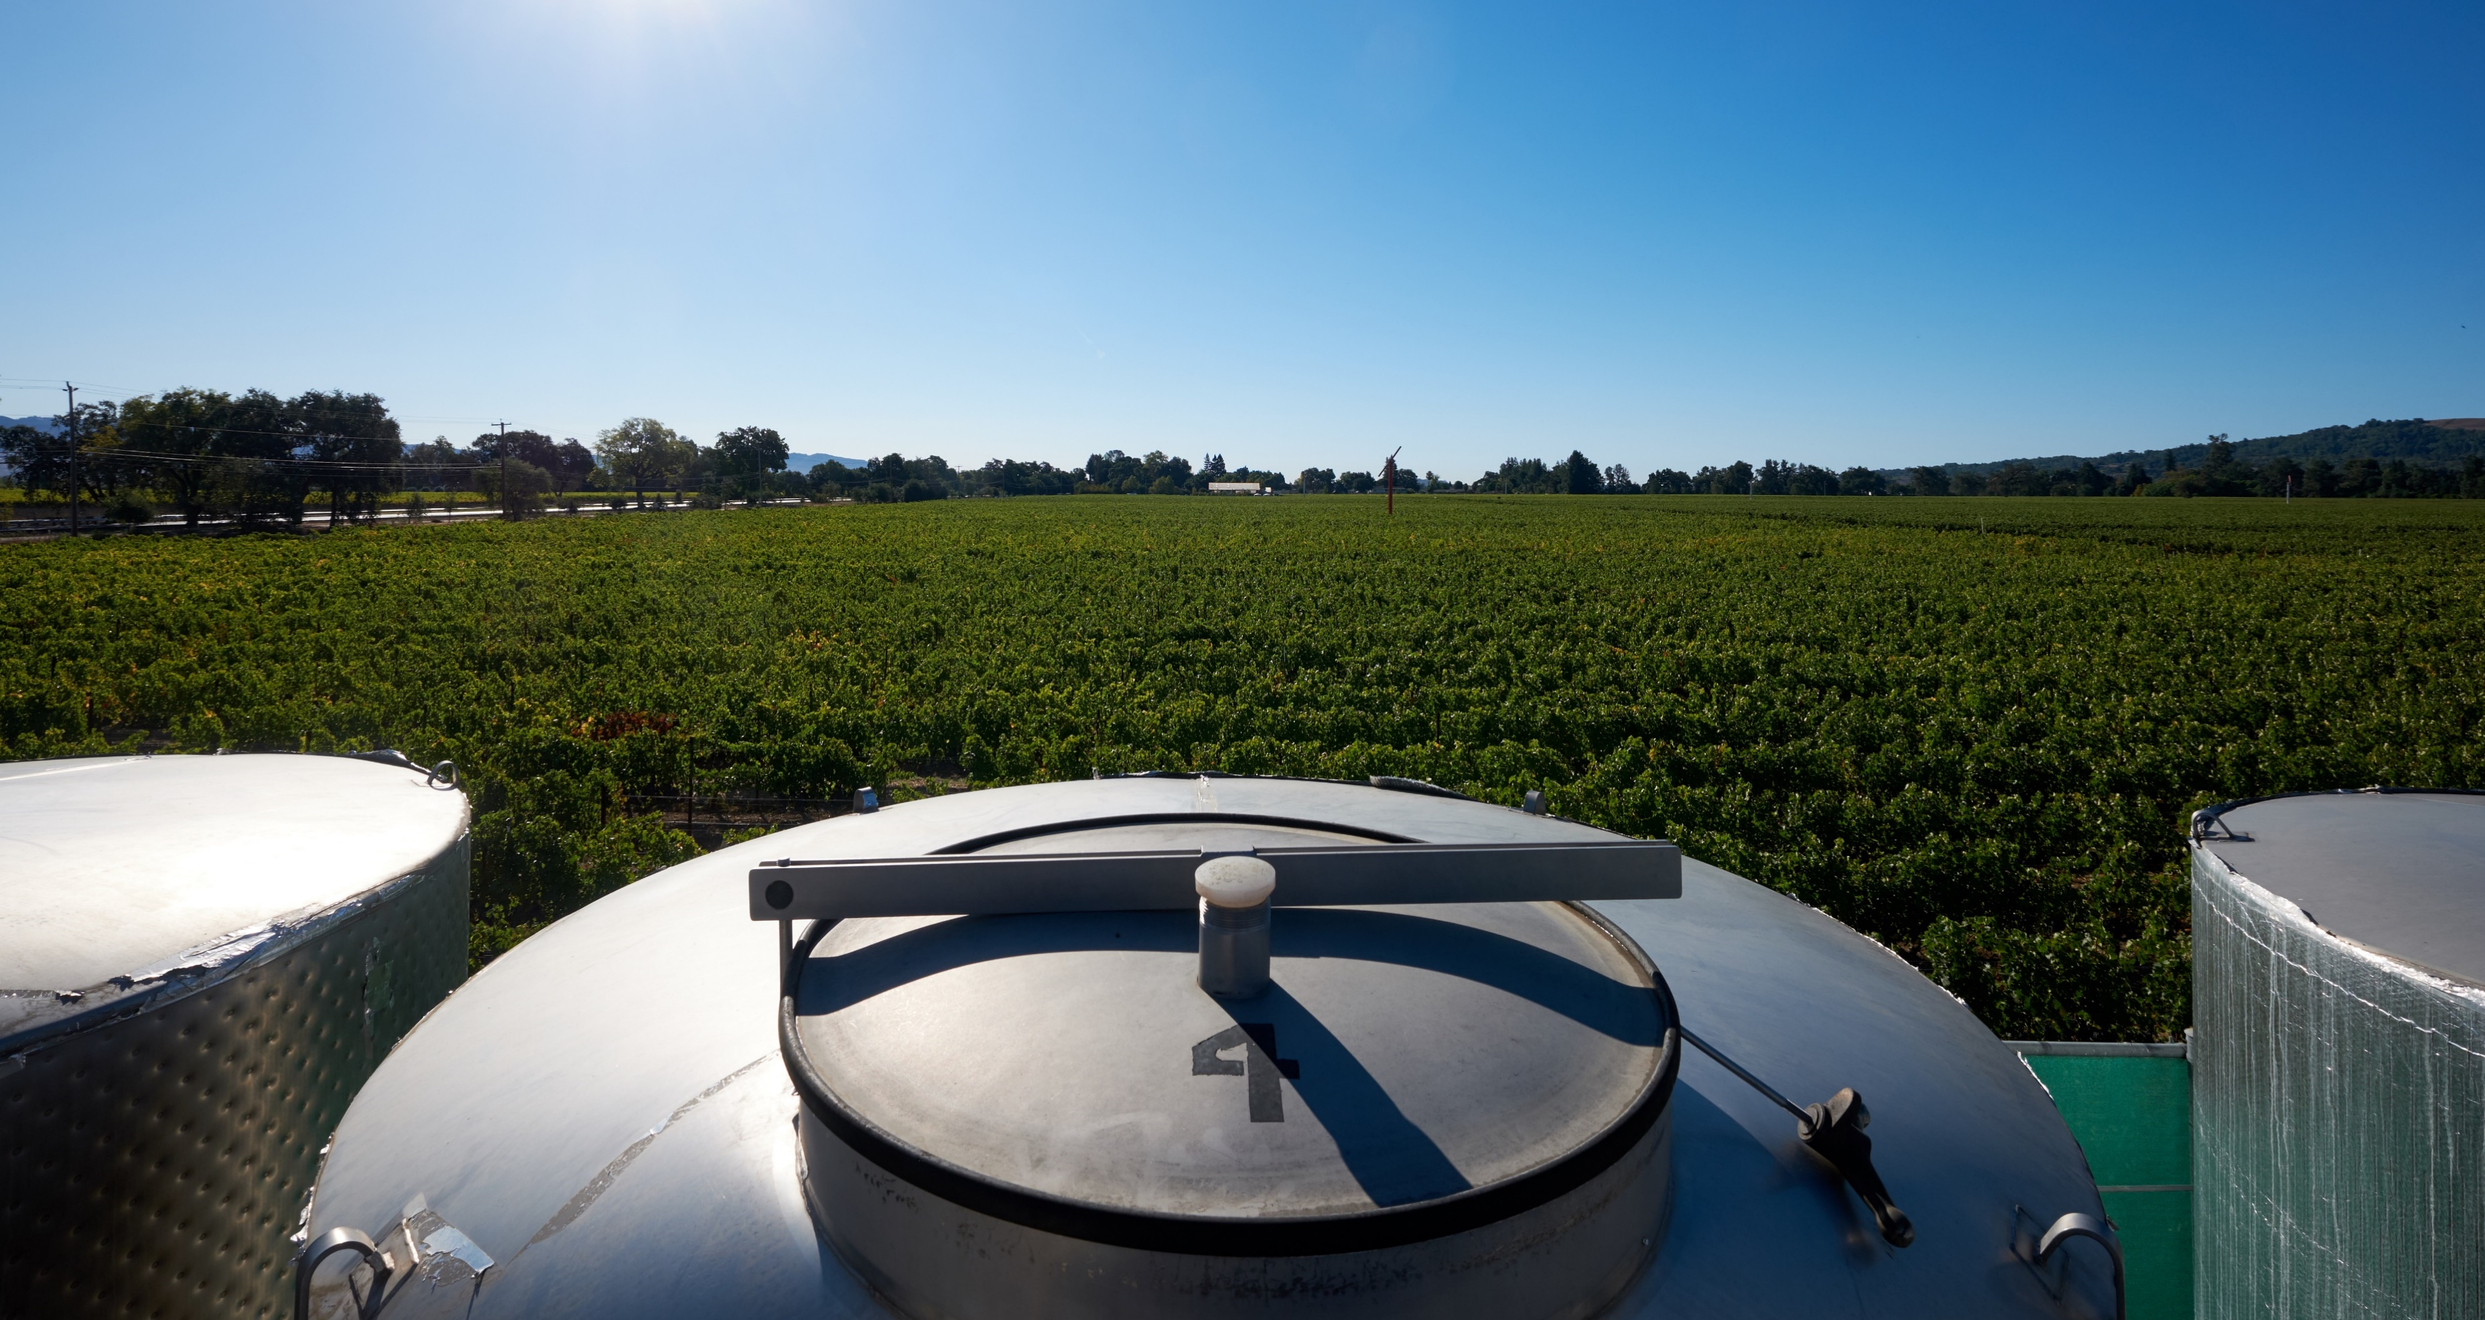
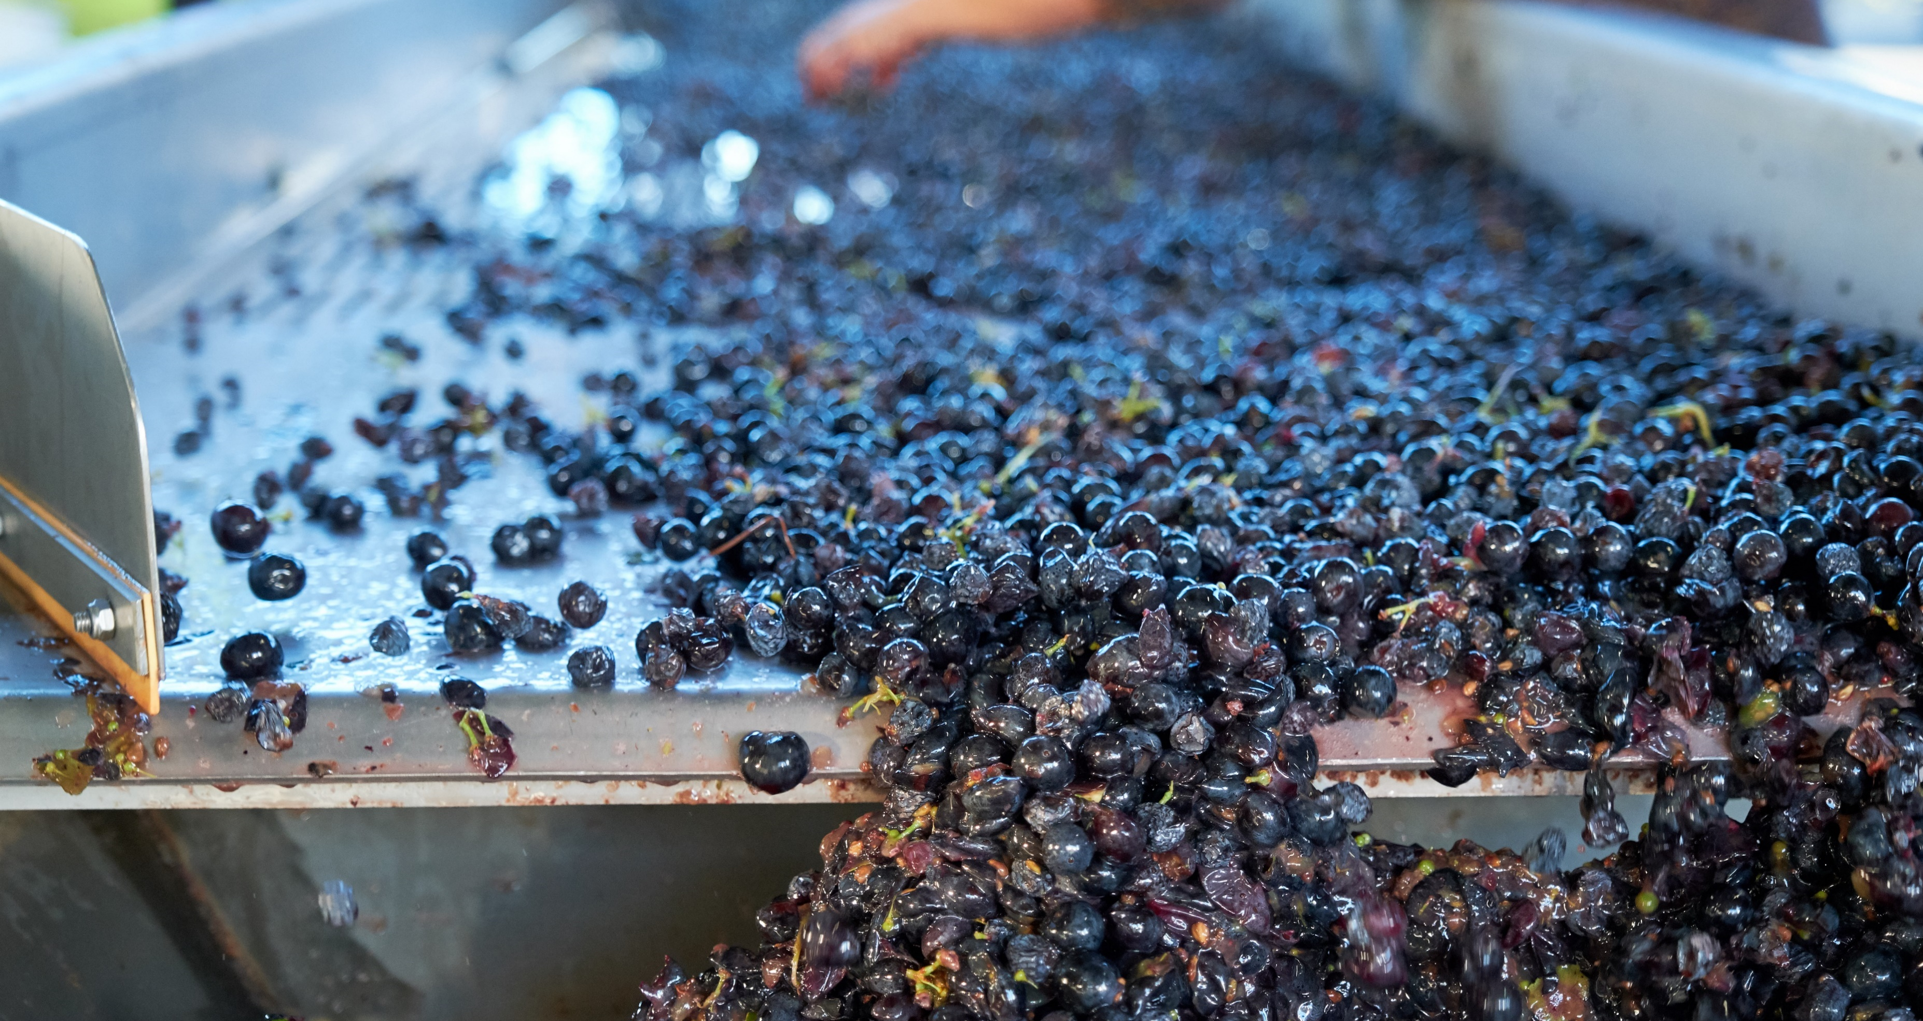
50 YEARS OF SILENUS WINERY
In 1968 a walnut orchard on the southwestern slope of Napa Valley was converted to Cabernet Sauvignon vineyards and the roots of Silenus Winery were firmly established. In 2004 this area became one of the sixteen sub AVAs (American Viticultural Area) in Napa Valley and is now known as Oak Knoll District of Napa Valley.
The vineyards were originally planted by aerospace engineer Bruce Newlan, and quickly gained a superior reputation. Through the 1970’s the grapes from this vineyard were sold to Robert Mondavi, Inglenook, Silver Oak and Clos du Val and consistently were used in their reserve wines.
Realizing what gold this 20-acre vineyard produced, Newlan built his own winery and began producing award winning wines. Eventually the grapes went exclusively into Newlan Winery and Robert Mondavi Reserve Cabernet.
Silenus is now celebrating 50 years of growing some of the most sought after grapes in Napa Valley.

Slide 5
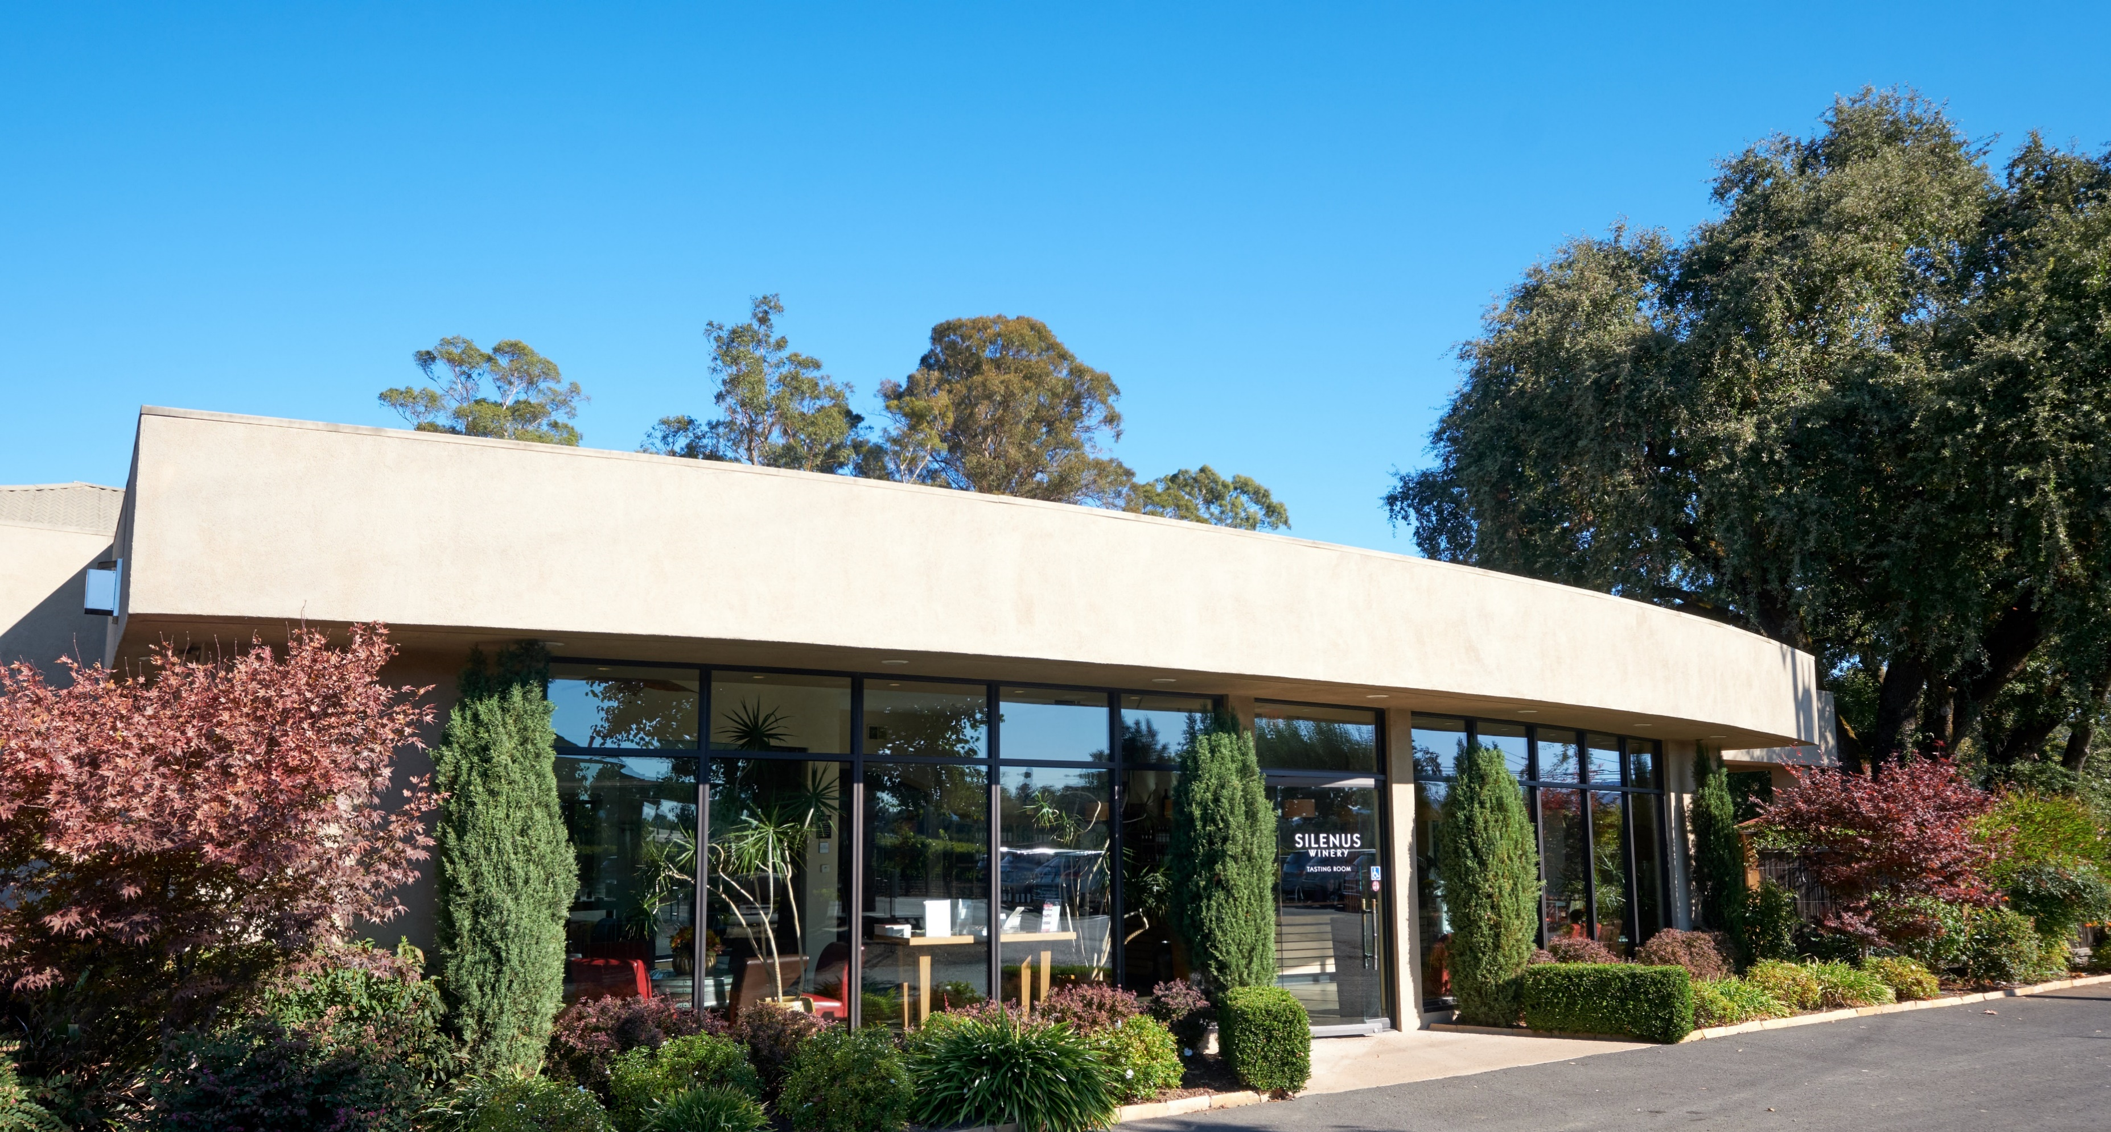
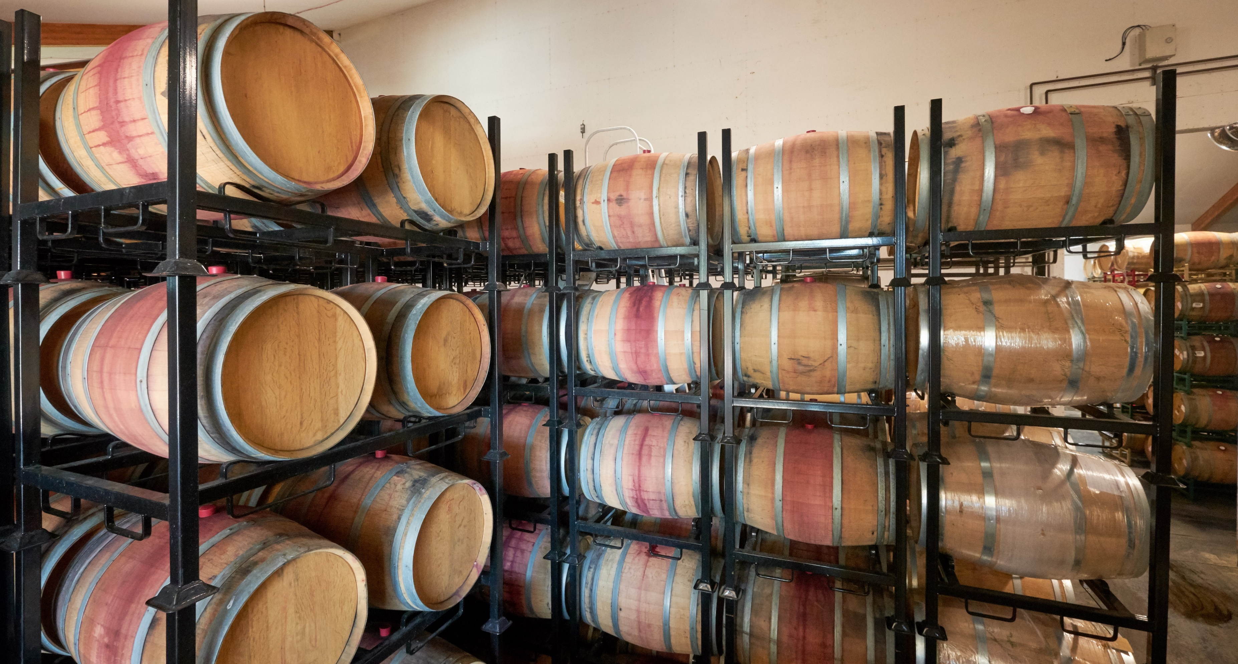
Silenus Winery Today
Newlan eventually sold the winery, and Scott Meadows was hired as President. Purchased by Chinese entrepreneur Veronica Wang in 2008, the winery was rechristened Silenus Winery and for years the wine was sold exclusively in China and Japan.
Over the years, state of the art production equipment, a 2,000 barrel aging cellar and a modern tasting room have been added.
Still under the direction of Scott, the winery today continues the tradition of small-production, premium winemaking . Silenus wines are now available in select markets of the United States as well as an expanding international presence.

Slide 6
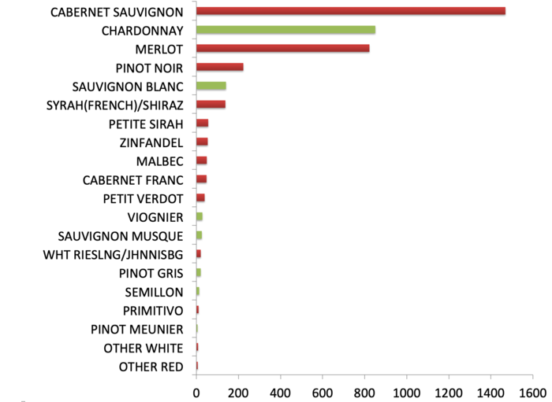
OAK KNOLL DISTRICT OF NAPA VALLEY
The Oak Knoll District (OKD) is known as the Sweet Spot of Napa appellations because of its range of temperatures and soils, giving the area the ability to grow many different grape varietals.
It is also one of Napa Valley’s oldest grape growing areas dating back to 1851. Today it has over 4,200 acres planted to almost 20 grape varietals.

Slide 7
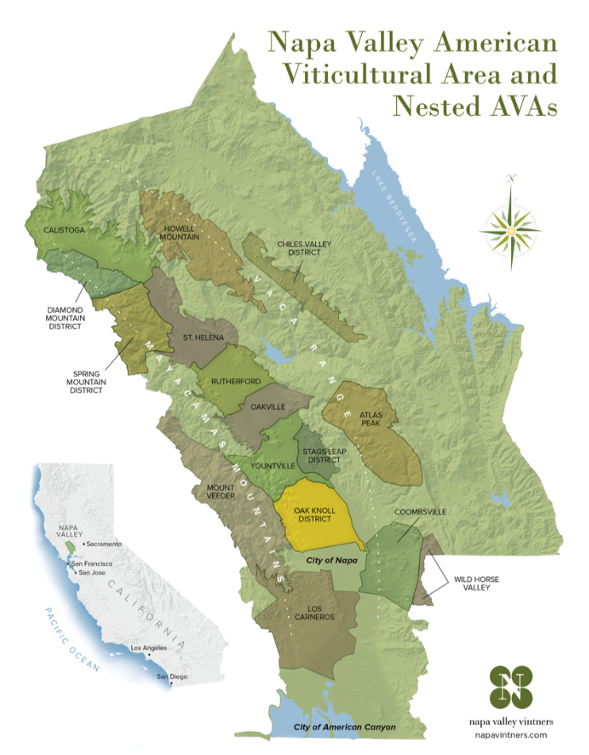
OAK KNOLL DISTRICT OF NAPA VALLEY
The topography of the AVA starts just south of the town of Yountville and ends just north of the town of Napa.
The western border starts at the top of Mount Veeder, where its downward slopes created alluvial soils from millennia of runoff from the mountain.
At the center of the appellation the land levels off and the soil becomes clay. Extending to the Silverado Trail, the AVA offers temperatures easily ten degrees warmer than St. Helena, and rainfall significantly higher.
With this range of climate and soil, Oak Knoll District can easily grow a mixture of grape types, thus earning the nickname The Sweet Spot.

Slide 8
THE WINES of SILENUS
The winery produces four wines, all from Oak Knoll District.
Chardonnay – from Red Hen Vineyard and Matthiasson Vineyards
Merlot – from Materra Vineyards
Cabernet Sauvignon – from the Silenus Estate just south of Darms Lane in the Dry Creek Watershed
Cabernet Sauvignon Reserve – the best of the best from the Estate. Small production and limited.

Slide 9
PRESS FOR SILENUS WINERY Consistently High Scores
SILENUS
OAK KNOLL CHARDONNAY
2021
92 Points James Suckling
2019
93 Points Wine Enthusiast
2018
91 Points Wine Enthusiast
2017
94 Points / Editor’s Choice Wine Enthusiast
OAK KNOLL MERLOT
2020
92 Points James Suckling
2019
91 Points James Suckling
2017
93 Points Wine Enthusiast
2016
91 Points Wine Enthusiast
OAK KNOLL CABERNET SAUVIGNON
2020
92 Points James Suckling
2019
92 Points James Suckling
2017
92 Points Wine Spectator
2016
94 Points James Suckling
OAK KNOLL CABERNET SAUVIGNON RESERVE
2020
92 Points James Suckling
2019
93 Points James Suckling
2018
91 Points Decanter
2017
90 Points Decanter
2016
94 Points Jeb Dunnuck
TYROS
NAPA VALLEY CABERNET SAUVIGNON
2019
91 Points Wine Spectator
2017
90 Points, Editor’s Choice Wine Enthusiast
90 Points Wine Spectator
2015
92 Points Decanter
91 Points & Editor’s Choice Wine Enthusiast
Updated 4/29/24

Slide 10
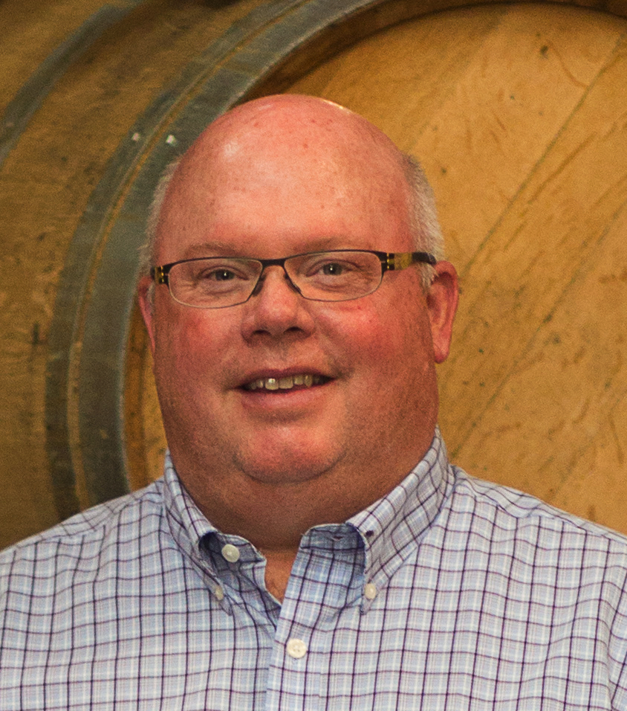
The Silenus Team
Scott Meadows
President
A native of Utah, Scott worked in Tokyo for years in marketing for language learning software for Apple. Scott has been President of Silenus for over twenty years. He, his Japanese wife and two daughters live in Napa.
Kendra Gillette
VP Sales & Marketing
With over 20 years of experience in the industry, Kendra has experience in sales for wholesalers, well known Napa wineries, and a top of the line barrel company. Her continuous success is truly a culmination of her work ethic, intelligence, and kindness.

Slide 11
Veronica Wang, Owner
Ms. Wang is a native of Zhengzhou, a city in central China known as a major hub of China’s national transportation network, with railways connecting Zhengzhou to Europe along the old Silk Road. Originally a property developer of many large residential buildings, she has expanded her reach to several other interests.
While living in Los Angeles, she discovered her love of wine and purchased Silenus Winery, and then recently created Meijing Vineyards in China, a luxury destination for high profile events.
Veronica has been very philanthropic, donating generously to children’s education and is building health clinics in China in conjunction with The Mayo Clinic.

Slide 12
Silenus, Mentor of Dionysus
Zeus, God of all Gods in ancient Greek mythology, had a son named Dionysus, God of Wine. At Dionysus’ birth Zeus appointed Silenus to teach his young son how to debauch and enjoy the finer things of life – like drinking wine!
Together they traveled the world, planting grapevines and raising bees for pollination while always enjoying copious amounts of wine. They carried a fennel stalk topped with a pinecone as a sign of hospitality. The Silenus label incorporates these elements – the grapevine, the fennel staff with a pinecone and the bees.

Slide 13
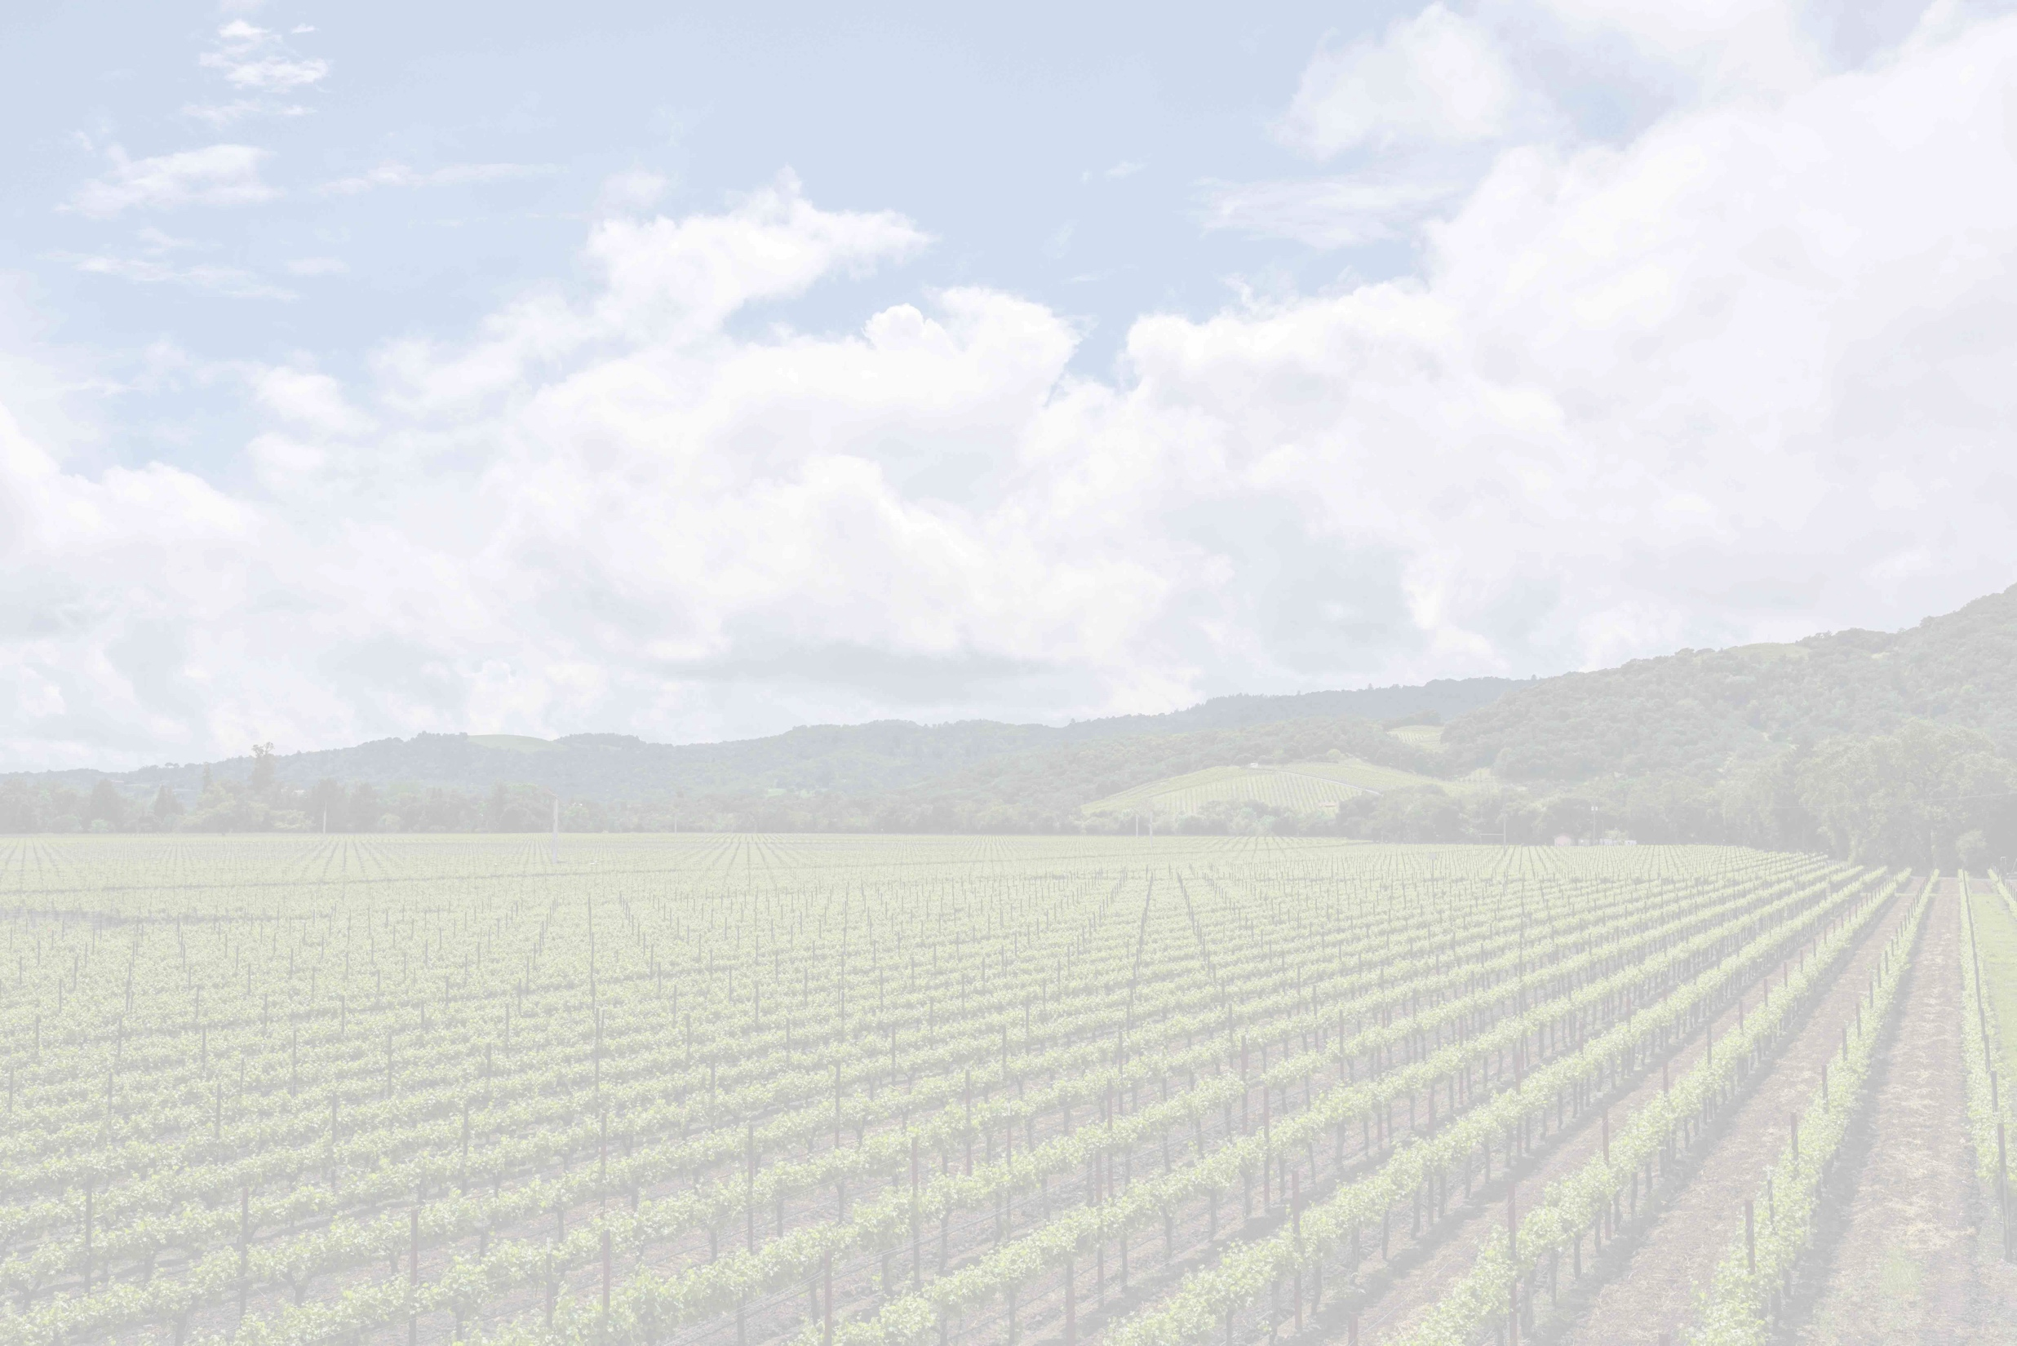
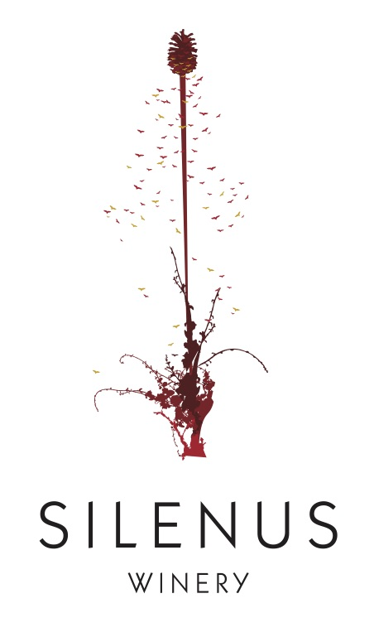
The Silenus Label
As Silenus and Dionysus traveled the lands far and wide, they hosted parties and planted vineyards. While traveling they always carried with them a fennel staff topped by a pinecone, a both a sign of welcome and hospitality.
The Silenus label pays homage to that welcome and combines four elements: a newly planted grapevine sprouting a fennel stalk, topped with a honeyed pinecone encircled by bees.
Silenus Wines are all Oak Knoll District and produced from estate vineyards and vineyards within the OKD.

Slide 14
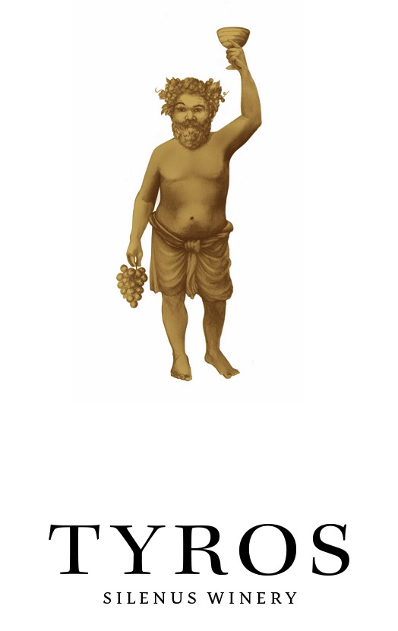
The Tyros Label
Tyros = “a beginner or student”
According to Greek mythology, Zeus, God of all Gods, appointed Silenus to teach his fledgling son, Dionysus, God of Wine, how to enjoy the pleasure of life, also known as debauching.
Silenus took this task to heart. As Silenus was mentor to Dionysus, Dionysus became the student, or Tyros, to Silenus. We see Dionysus on the Tyros label as he has clearly been imbibing wine. He seems to be asking us to join him, and to above all, ENJOY!
Produced from grapes purchased throughout Napa Valley, our Tyros Cabernet Sauvignon celebrates great wine made to be accessible and enjoyed with the pleasures of a great meal.

Slide 15
Our logo represents elements from both Silenus and Tyros. From the Silenus label is the pinecone at the top, bees to the left, a grapevine at the bottom, and to the right is the T from the label of Tyros Cabernet, all crossed with the fennel stalks from the Silenus label.

